Slide 1
Data mining for Business Analytics
Overfitting Problem & Cross Validation
ISOM3360
Lab 3

Slide 2
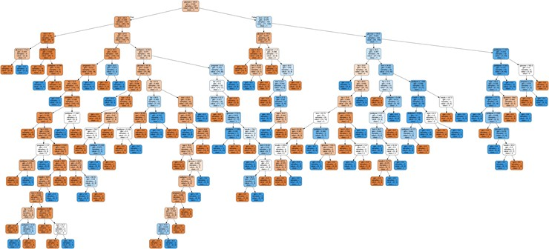
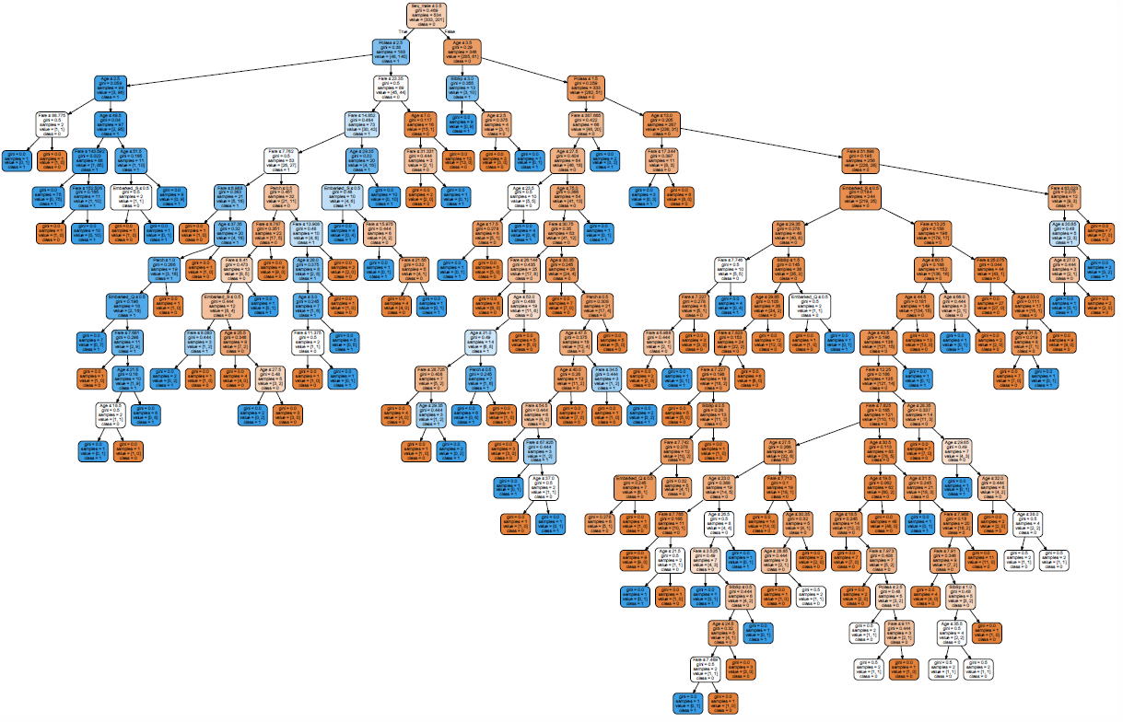
Recall from last lab
Does everyone generate the same accuracy rate when random state are different in data splitting stage? NO
Is it possible: Different training data sets to generate same model?

Slide 3
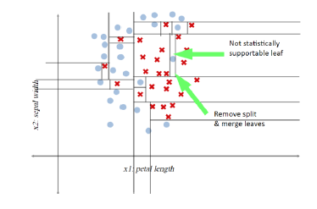
Overfitting problem
Learning by simply remember everything
No generalized rules or patterns have been learned or found
Growing to Purity is Bad (Decision Tree Example)

Slide 4
Split data
Attributes and Target Variable
Use all attributes except “Name” as independent variable
Set “Survived” as target variable
Let’s try 60-40 split
features = ['Pclass','Age','SibSp','Parch','Fare','Sex_male','Embarked_Q','Embarked_S']
target = ['Survived']
X = train [features]
y = train [target]
from sklearn.model_selection import train_test_split
X_train, X_val, y_train, y_value = train_test_split(X, y, test_size=0.4, random_state = 42)

Slide 5
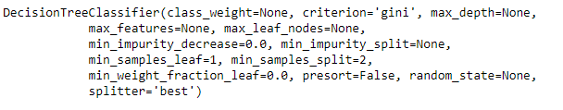
Build the model based on 60% training data
Import Decision Tree model and evaluation matrix
Fit the model with the training data (60%)
from sklearn.tree import DecisionTreeClassifier
from sklearn.metrics import accuracy_score
from sklearn.metrics import confusion_matrix
model = DecisionTreeClassifier()
This model uses all the default value for all hyperparameters for the decision tree classifier
model.fit(X_train, y_train)

Slide 6
Decision Tree Classifier from sklearn
criterion: The function to measure the quality of a split. Supported criteria are “gini” for the Gini impurity and “entropy” for the information gain.
max_depth : The maximum depth of the tree. If None, then nodes are expanded until all leaves are pure or until all leaves contain less than min_samples_split samples.
min_samples_split : The minimum number of samples required to split an internal node:
If int, then consider min_samples_split as the minimum number.
If float, then min_samples_split is a fraction and ceil(min_samples_split * n_samples) are the minimum number of samples for each split.

Slide 7
Decision Tree Classifier from sklearn
min_samples_leaf : The minimum number of samples required to be at a leaf node. A split point at any depth will only be considered if it leaves at least min_samples_leaf training samples in each of the left and right branches.
If int, then consider min_samples_leaf as the minimum number.
If float, then min_samples_leaf is a fraction and ceil(min_samples_leaf * n_samples) are the minimum number of samples for each node.
max_leaf_nodes : Grow a tree with max_leaf_nodes in best-first fashion. Best nodes are defined as relative reduction in impurity. If None then unlimited number of leaf nodes.
min_impurity_decrease : A node will be split if this split induces a decrease of the impurity greater than or equal to this value.

Slide 8

Result from different testing datasets
Test model based on testing data (40%)
View the evaluation result
What is the performance based on training data (60%)?
pred_val = model.predict(X_test)
# print evaluation result on 40%
print("Accuracy from 40% test data:",accuracy_score(y_test, pred_val_test, normalize=True, sample_weight=None))
print(confusion_matrix(y_test, pred_val_test))
pred_val_train = model.predict(X_train)
print("Accuracy from 60% train data:",accuracy_score(y_train, pred_val_train, normalize=True, sample_weight=None))
print(confusion_matrix(y_train, pred_val_train))

Slide 9
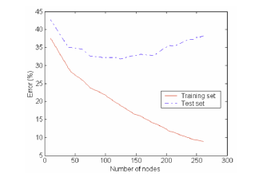
How to avoid overfitting in decision tree
Control the hyperparameters
max_depth
min_samples_split
min_samples_leaf
max_leaf_nodes
min_impurity_decrease

Slide 10
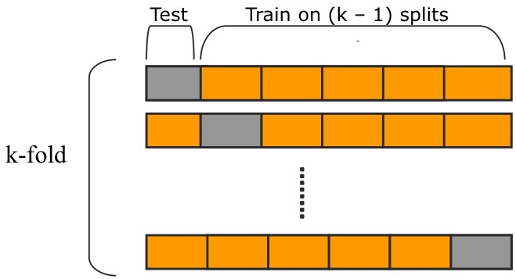
Train-Test Split VS Cross Validation
Learning the parameters of a prediction function and testing it on the same data is a methodological mistake
Evaluation result from single split of train and test is not reliable
Evaluation result of K folds Cross validation is an averaged result

Slide 11
Cross validation
Import cross validation
Use all data to do 10-fold cross validation
Check the accuracy result from each run of cross validation
Average of the accuracy result
# import cross validation
from sklearn.model_selection import cross_val_score
score_cv = cross_val_score(model, X, y, cv=10)
score_cv
score_cv.mean()

Slide 12
Cross validation
How many models it build through cross validation?
Which model we choose as the final one to use in prediction? The one with highest accuracy?
Cross validation is used to tune the model hyperparameters, once you have good enough evaluation result from CV, you would apply such hyperparameter settings and build the model by using ALL the training data and the model will be used in the predicting phase

Slide 13
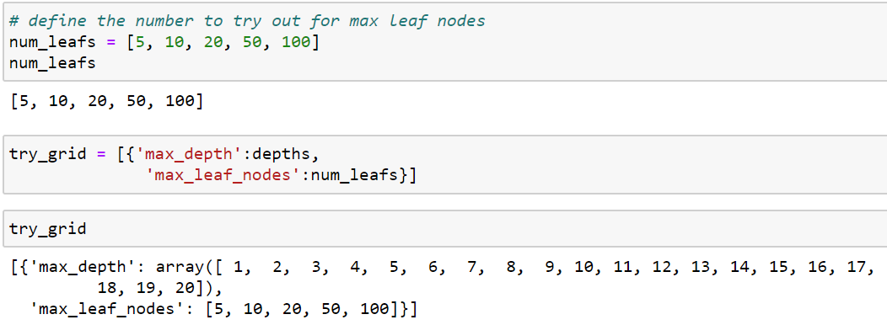
GridSearchCV
exhaustive search over specified parameter values for an estimator/model
The parameters of the estimator used to apply these methods are optimized by cross-validated grid-search over a parameter grid.
Set param_grid: Dictionary with parameters names (string) as keys and lists of parameter settings to try as values
# import GridSearchCV
from sklearn.model_selection import GridSearchCV

Slide 14
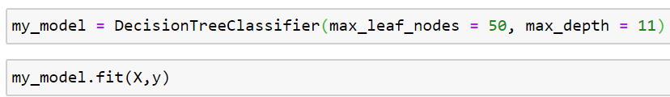
GridSearchCV
GridSearchCV implements a “fit” and a “score” method. It also implements “predict”, “predict_proba”, “decision_function”, “transform” and “inverse_transform” if they are implemented in the estimator used.
Finally, build your model with best parameters, using all the training data
# define your Model using GridSearchCV
DTM = GridSearchCV(DecisionTreeClassifier(), param_grid=try_grid, cv=10)
# fit your Model with training data
DTM.fit(X,y)
# find the best parameters
DTM.best_params_
# find the accuracy from best parameters
DTM.best_score_

